Slide 1
Quality education
Atlassian’s problem statement

Slide 2

Aim:
The aim of this problem statement is to leverage state of the art technology to make educational platforms more robust and unleash the potential of the pupils, instructors and the classroom by accurate monitoring through:
Automated Attendance (through photographs or video camera)
Student performance (analyzing past metrics and raising red flags)
TLDR (Summarizing lectures)
Attentiveness Detection (gaze tracking and posture recognition)
Student Sentiment (basic social media tracking)
Reference Building (Hyperlinking concepts to related articles)

Slide 3
Lecture Synopsis
Keyword extraction and summary
Summarizing
Works using nltk.
We first tokenize the source text to words and then get the frequency table for words that are not commonly used in english.
Then we tokenize sentences and prioritize them based on how many important words they contain.
These sentences are then concatenated to form the summary.
Notes:
NLP TOKENIZER FOR SUMMARISING
BREAKS THE SOURCE TEXT INTO WORD TOKENS AND PHRASE TOKENS AND THEN ANALYSES IT
FREQUENTLY USED WORDS ARE ANALYSED A AND THE ARE REMOVED
FREQUENCY TABLE IS USED AND MADE
PHRASE TOKEN-RANKED ACCORDING TO THE IMPORTANCE AND FREQUENCY OF IMPORTANT WORDS IN THESE PHRASES
SENTENCES WHICH ARE MORE IMPORTANT ARE FORMED AND A SUMMARY IS CREATED

Slide 4
Lecture Synopsis
Keyword extraction and summary
Keyword extraction
Works using YAKE(Yet Another Keyword Extractor).
The keywords are ordered according to their frequency in the text and then the top 10 are selected.
It works on the statistical properties of the source text and finds the most dominant words in the text.
Notes:
Machine learning in the form of a keyword extractor
Keyword is hyperlinked with a wikipedia site for additional information on the keywords

Slide 5
Student performance analysis
Academic performance monitored as per the performance in the quarterly examinations.
The performance is expressed in the form of graphs for better representation.
Notes:
Students’ performance is monitored in the form of their performance in the quarterly examinations and the performance trends are shown in the form of graphs so that it’s easier for both the teacher and the student to analyze their performance in each subject and thus may give an insight as to what are their weak points and where should they focus more.

Slide 6
Automated attendance system
Smart ID cards and facial recognition
Attendance system
Face detection and facial recognition of people for a more efficient and less time consuming system.
Works using ‘openCV-python’ and ‘face-recognition’ libraries.
The face is detected from an image using Histogram of Gradients (HOG) algorithm and the location of the face is taken as output.
The face is then encoded using it's location to give 128 parameters using the pre-trained neural network.

Slide 7
Automated attendance system
Smart ID cards and facial recognition
The encodings between different images are matched to recognise faces.
The faces with the least “facial_distance” are most similar to each other and hence can be used to recognise faces.
Smart ID cards provided to the students that they need to punch in for attendance.

Slide 8
Attentiveness detection
Gaze tracking and posture recognition
Gaze tracking
This is to monitor the eye movement of the students and analyze how often their eyes waver from the screen and their basic attention span.
This can be further used as a metric to train a machine learning model to measure the attentiveness in the classroom.
This can act as an insight to the teachers to make the class more interactive.
Notes:
We are using gaze tracking and posture detection as metrics to measure the attentiveness of the students in the classroom. The system detects the student as attentive as long as they are looking forward and not getting distracted. This can be used with a machine learning model to improve upon the system along with the posture as another metric.
Gaze detection works by identifying parts of the face and then selecting the darkest portions in areas where the eye is supposed to be.
Haarcascade filters are used to identify the face and the eyes and then blob detection is used to identify the eyebrows and get rid of them for better processing. To detect the eyes we need to threshold the image but the value of the thresholding may vary according to the lighting conditions. For now we are using a trackbar to adjust for the lighting conditions but this can also be automated.

Slide 9
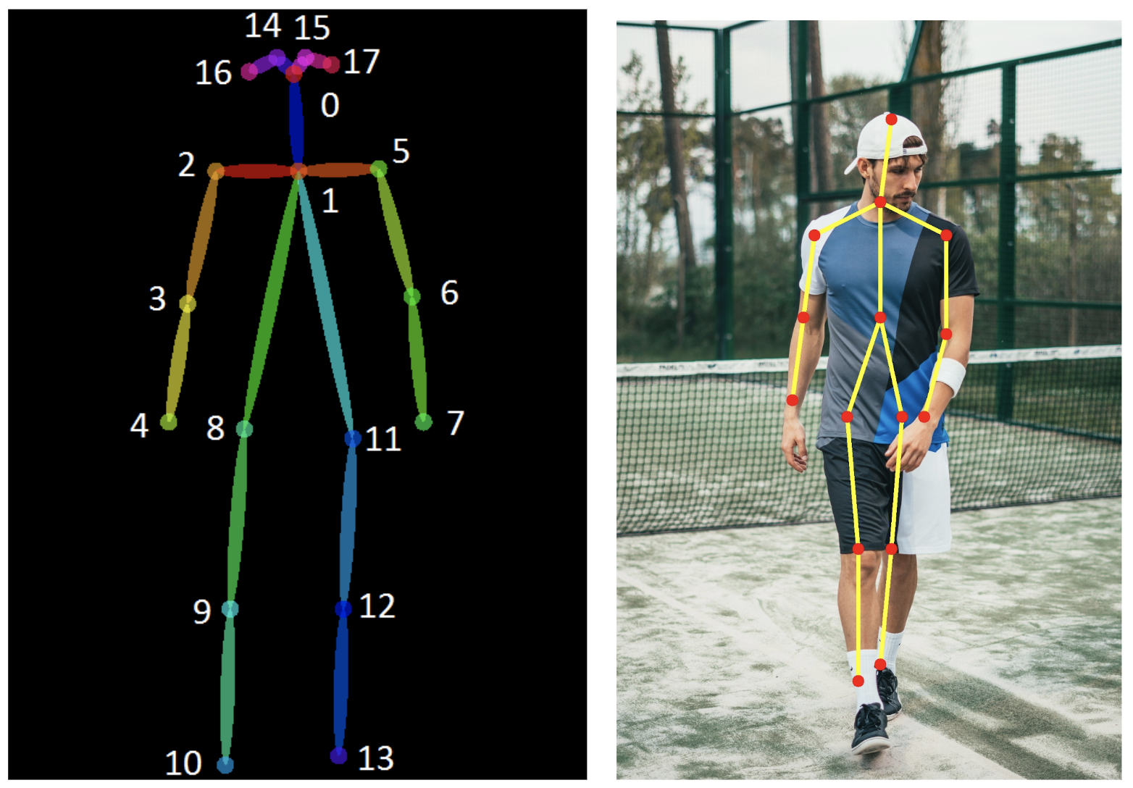
Attentiveness detection
Gaze tracking and posture recognition
Posture recognition
Implementation using Python | openCV |Tensorflow frozen models
Human Pose Estimation is defined as the problem of localization of human joints (also known as keypoints - elbows, wrists, etc) in images or videos
2D Pose Estimation - Estimate a 2D pose (x,y) coordinates for each joint from a RGB image.
Notes:
Posture recognition is basically localization of the body parts.Work regarding this adding heat maps and making the existing algorithms with neutral networking and deep learning.Due to openCV,we can easily use tensorflow frozen models.In this,basically 2d pose estimation is inculcated with x and y coordinate system.Points are initially recognized and numbered from 0 to 18 ranging from the neck and the skull to the spine,elbows,arms,knees and legs.Maximum points out of these need to be recognized and their heatmap is generated.Once the local maximas are found,the x,y points need to be appended one and one.After this,they need to be paired with one another and the connecting lines will be drawn.A pose estimation function is created.Live estimation could be performed using the live camera.The deep learning pose estimation
Common Evaluation Metrics
Percentage of Correct Parts - PCP: A limb is considered detected (a correct part) if the distance between the two predicted joint locations and the true limb joint locations is less than half of the limb length (Commonly denoted as PCP@0.5).
It measures the detection rate of limbs. The con is that it penalizes shorter limbs more since shorter limbs have smaller thresholds.
Higher the PCP, better the model.
Percentage of Correct Key-points - PCK: A detected joint is considered correct if the distance between the predicted and the true joint is within a certain threshold. The threshold can either be:
PCKh@0.5 is when the threshold = 50% of the head bone link
PCK@0.2 == Distance between predicted and true joint < 0.2 * torso diameter
Sometimes 150 mm is taken as the threshold.
Alleviates the shorter limb problem since shorter limbs have smaller torsos and head bone links.
PCK is used for 2D and 3D (PCK3D). Again, the higher the better.
Percentage of Detected Joints - PDJ: A detected joint is considered correct if the distance between the predicted and the true joint is within a certain fraction of the torso diameter. PDJ@0.2 = distance between predicted and true joint < 0.2 * torso diameter.

Slide 10

Student Sentiment
Student Sentiment
(basic social media tracking)
Indicators about the mental health of a student are highly valuable to an academic institution.
The aim is to provide insights to teachers/counselors about students' psychological and emotional state
By monitoring their interactions on (the all-time popular) social media and analyzing their performance trends, academic or otherwise.
The sentiments is specific to an
educational setting - academic pressure, bullying
Primary sources for these interactions will be the campus platforms and popular social media platforms..
Tracking some of the public mentioned keywords that account for threats like cutting, cyberbullying, and suicide.
When these keywords are set up in the required and excluded section of the tool, it send notifications whenever these are used in the phrases with other words
Notes:
Social media monitoring It works by tracking some of the public mentioned keywords that account for threats like cutting, cyberbullying, and suicide. There are specific social media monitoring tools that work on this very principle where they track certain keywords to account for the danger that might be becoming. These keywords can like guns, bullets, knives, cutting, depression, etc.
When these keywords are set up in the required and excluded section of the tool, it notifies the team whenever these are used in the phrases with other words. This way the staff members can quickly identify the danger that is associated with a certain student. This gives them the head start to investigate further what is going on.
Through the posts kids are sharing, the content they are searching, and the types of comments they are making, their mental state can be analyzed
As far as their privacy is concerned, schools are not invading their private chats and knowing their secrets.

Slide 11
Workstations in the git project
Hackfest 2022
Basics
Intermediate
Basics
Intermediate
Python was used as a programming language.
Lecture synopsis
Keyword detection
Gaze tracking and posture detection
1 |  | 2 |  |  | 3 |  |  |  | 4
Automated attendance system
Performance Analysis
Hashtag tracking system for mental health

Slide 12
Additional suggestions
An anonymous doubt portal can be designed for every section or classroom so that students can ask doubts without any hesitation.
Languages like C# and C++ could be used to code this.
Notes:
Since many students hesitate to ask doubts in class fearing how it may affect their image in their peer groups, we propose the use of a platform where doubts can be asked anonymously by students.
This will also increase the interactions between the students and the teachers.
It will be of particular help during online classes as the students don’t have the opportunity to ask their doubts just after the class as they do in offline classes.

Slide 13
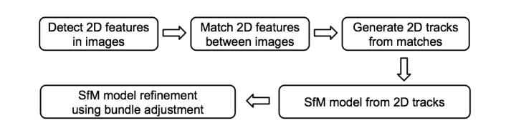
Structure from motion
3D models of lab equipments and important diagrams and instrumentation used in the course could be digitally created for more clarity on the subject
Structure from motion (SfM) is a photogrammetric range imaging technique for estimating three-dimensional structures from two-dimensional image sequences that may be coupled with local motion signals. It is studied in the fields of computer vision and visual perception.
Notes:
In biological vision, SfM refers to the phenomenon by which humans (and other living creatures) can recover 3D structure from the projected 2D (retinal) motion field of a moving object or scene.
Steps
The first two steps of SFM algorithm: feature point extraction and matching
Detect 2d features in every input image
Match 2D features between images
Construct 2d tracks from the matches
Solve for the sfm model from the 2d tracks
Refine the sfm model using bundle adjustement

Slide 14

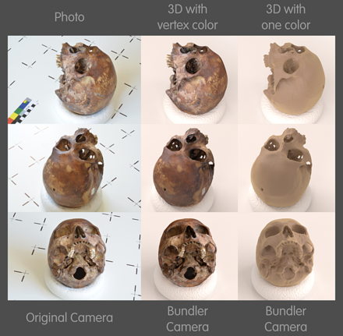
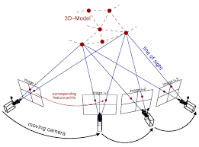
Structure from motion

Slide 15

Team Voldemort
Team Members:
Aaditya Pramod
Dikshita Pillai
Akhil Nair
Maria Rose

